Slide 1
IX.2408 - Initiation à la Recherche
PRESENTATION
Histological images by parallel computing
on Apache Spark
GUO Xiaofan
LIU Qinyu
31 / 05 / 2024

Slide 2
CONTENT
Introduction
Research Papers Review
Summary of Key Findings
Conclusion
References

Slide 3
1.Introduction
What are histological images?
Microscopic images of tissue sections stained to highlight structures such as cells and their components.
Why analyze histological images?
Essential for diagnosing diseases, understanding tissue morphology, and identifying pathological changes, aiding in disease detection and classification.
How does parallel computing benefit big data analysis?
Enables simultaneous processing of large datasets, reducing computation time and improving efficiency.​
What is Apache Spark?
An open-source, distributed computing system for big data processing, known for its speed, ease of use, and efficiency in handling large-scale data and iterative algorithms.

Slide 4
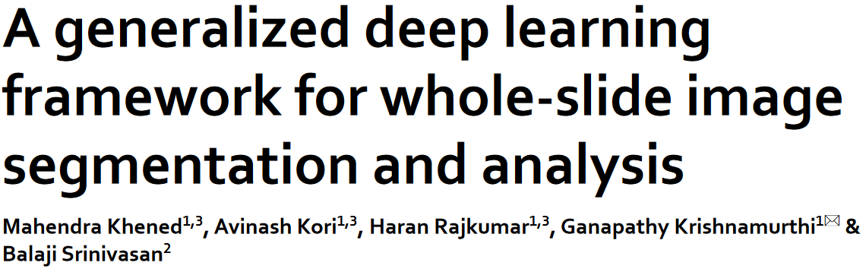
2. Papers-1
Histological images type:
Whole-slide images (WSI) for histopathological tissue analysis.
Parallel computing technology:
Training pipeline
Inference pipeline
Ensemble segmentation model
Main methods:
Deep learning framework for histopathological image analysis
Ensemble segmentation model
Lymph node metastases classification
Uncertainty estimation
Conclusion and achievements:
Introduced a deep learning framework to improve efficiency in histopathology tissue analysis.
Demonstrated significant improvements in segmentation accuracy and reliability.
DOI link: https://doi.org/10.1038/s41598-021-90444-8

Slide 5
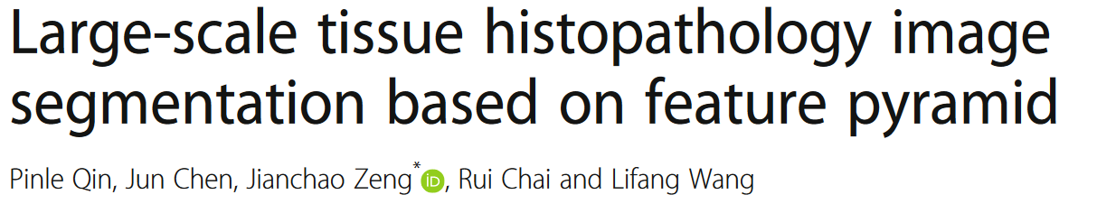
2. Papers-2
Histological images type:
Whole-slide images (WSI) for histopathological tissue analysis.
Parallel computing technology:
feature pyramid (ResNet50-GICN-GPP)
Patch sampling method to resample images
Multi-scale feature extraction using GICN and GPP structures
Main methods:
ResNet50-based convolutional neural network
Patch sampling for data resampling
Integration of multi-level features through GICN
Multi-scale semantic information exploration with GPP
Conclusion and achievements:
Improved segmentation accuracy (63% Dice coefficient) .
Demonstrated effectiveness across different cancer types.
DOI link: https://doi.org/10.1186/s13640-018-0320-8

Slide 6
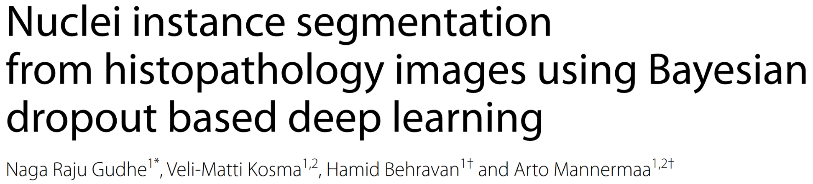
2. Papers-3
Histological images type:
Histopathology images with nuclei segmentation.
Parallel computing technology:
Bayesian deep learning methods
Monte-Carlo dropout for uncertainty estimation
Main methods:
Bayesian representation for nuclei segmentation
Use of deep learning models like U-Net and Hover-net
Monte-Carlo dropout for enhanced model uncertainty estimation
Conclusion and achievements:
Achieved superior segmentation performance and uncertainty estimation.
Outperformed existing models in terms of F1-score and IoU on the PanNuke dataset.
DOI link: https://doi.org/10.1186/s12880-023-01121-3

Slide 7
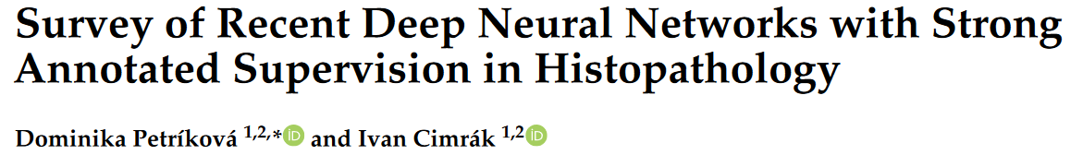
2. Papers-4
Histological images type:
Various histopathology images.
Parallel computing technology:
Survey of technologies focusing on deep neural networks
Main methods:
Comparison and analysis of recent deep learning techniques
Overview of neural network architectures for histopathology
Conclusion and achievements:
Provided an overview of the latest advancements in deep learning for histopathology
Highlighted strengths and weaknesses of different neural network architectures
DOI link: https://doi.org/10.3390/computation11040081

Slide 8
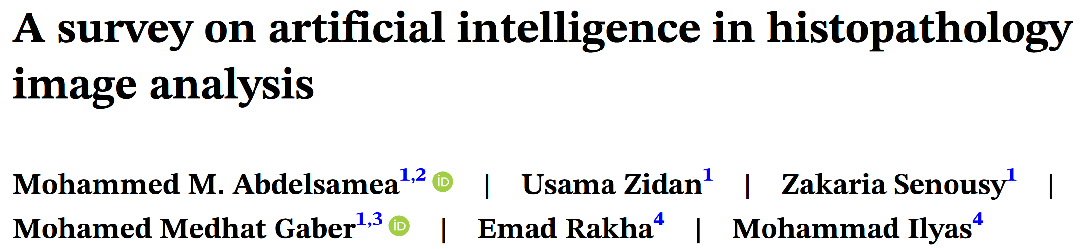
2. Papers-5
Histological images type:
Various histopathological images across studies.
Parallel computing technology:
Discusses various AI and machine learning approaches
Main methods:
Survey of AI applications in histopathology
Analysis of deep learning and machine learning techniques
Conclusion and achievements:
Comprehensive review of AI applications in histopathology.
Identified key trends and future research directions.
DOI link: https://doi.org/10.1002/widm.1474

Slide 9

2. Papers-6
Histological images type:
Nuclei segmentation in histopathological images.
Parallel computing technology:
Discusses deep learning methods without specific parallel computing focus
Main methods:
Survey of recent deep learning trends
Comparison of various models and techniques for nuclei segmentation
Conclusion and achievements:
Highlighted recent trends and advancements in deep learning for nuclei segmentation
Provided insights into performance and challenges of different segmentation models
DOI link: https://doi.org/10.1007/s12530-023-09491-3

Slide 10
3. Summary of Key Findings

Slide 11
4. Conclusion

Slide 12
5. References

